Slide 1
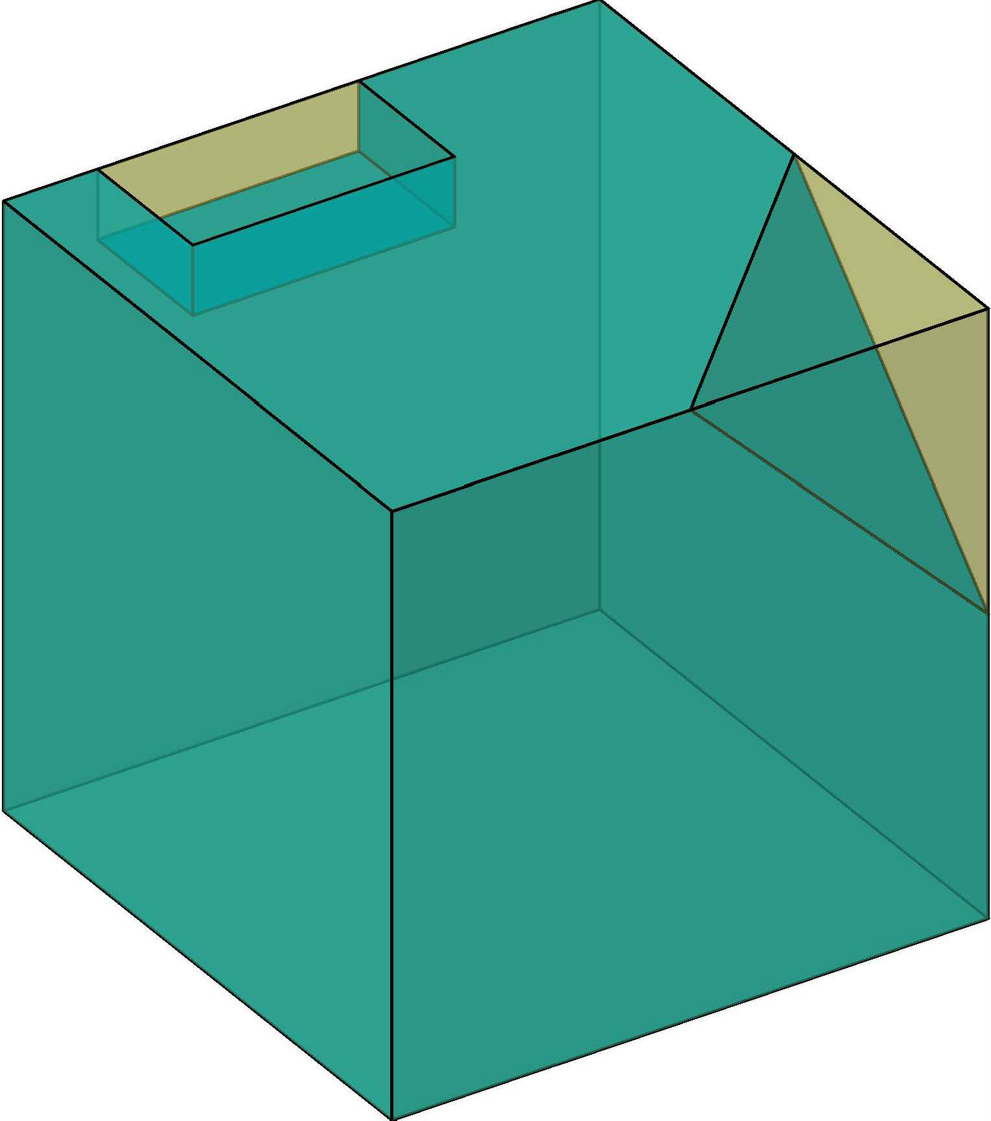
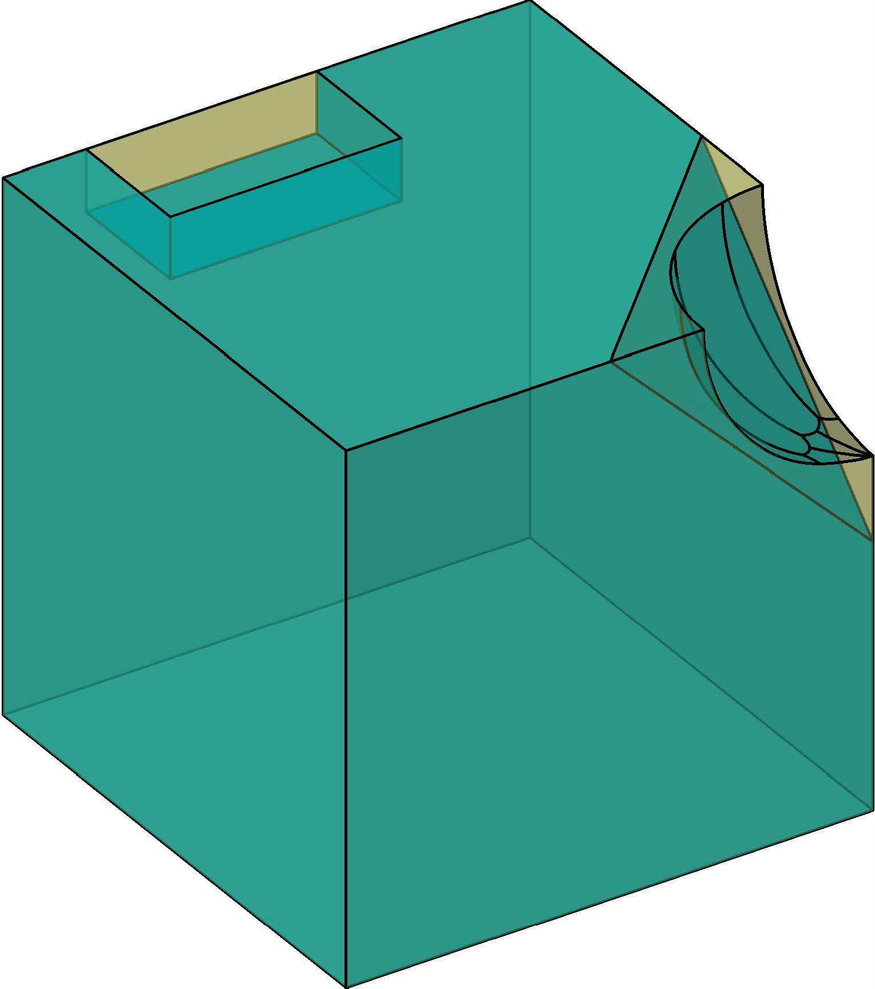



Safe

Unsafe
Exists one box always detect correct
$$d≤κ$$
Output Approximation
NMS Verification
Bounds Refinement
Suspect
$$d>κ$$

